Slide 1
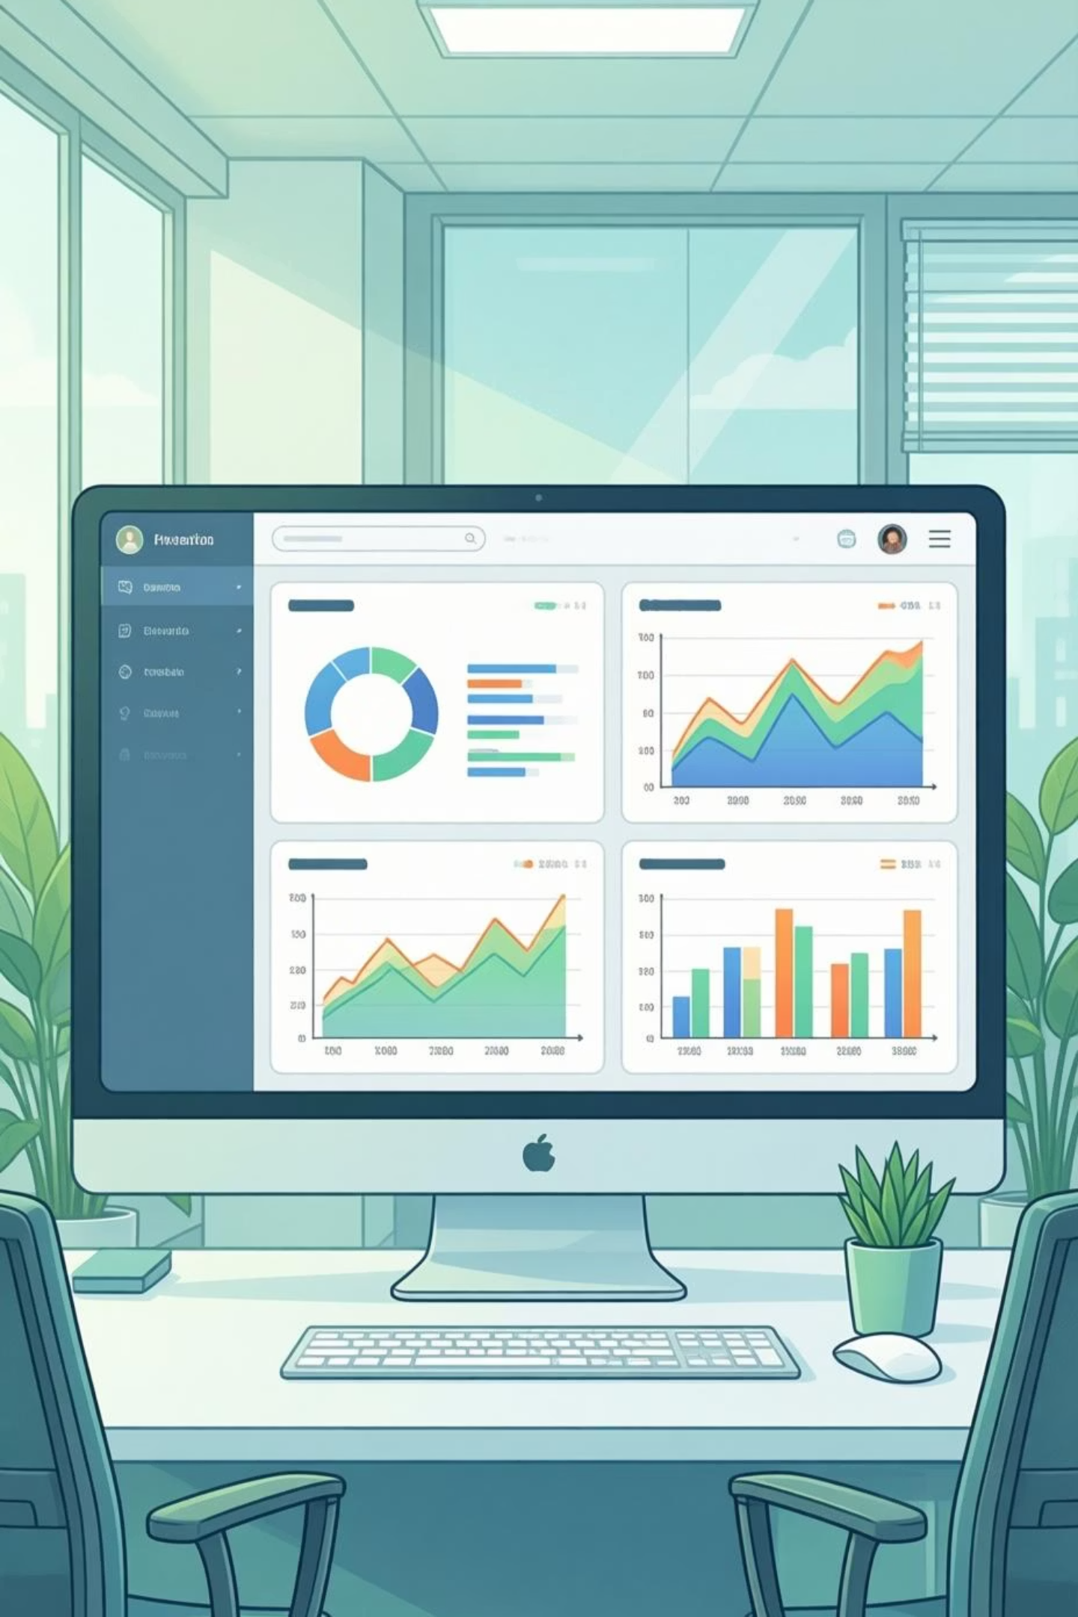
Customer Shopping Behavior Analysis
Uncovering insights from 3,900 purchases to drive strategic decisions

Slide 2

PROJECT SCOPE
Business Problem
The company wants to better understand customer shopping behavior in order to:
Core Business Question:
Improve sales performance
Increase customer engagement and loyalty
Optimize marketing and product strategies
Key areas of interest include:
Demographics and customer segments
Product categories and purchasing trends
Discounts, subscriptions, and repeat purchases
Revenue contribution across different customer groups
How can the company leverage consumer shopping data to identify trends, improve customer engagement, and optimize marketing and product strategies?

Slide 3
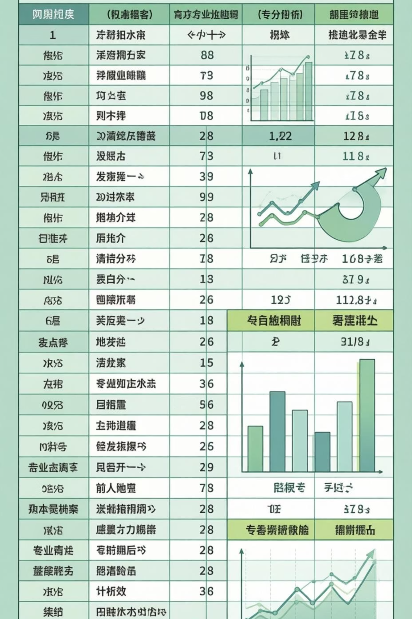
Dataset at a Glance
3,900
18
50
Total Records
Data Points
Locations
Customer transactions analyzed
Features per transaction
Geographic coverage
25
Products
Unique items tracked

Slide 4
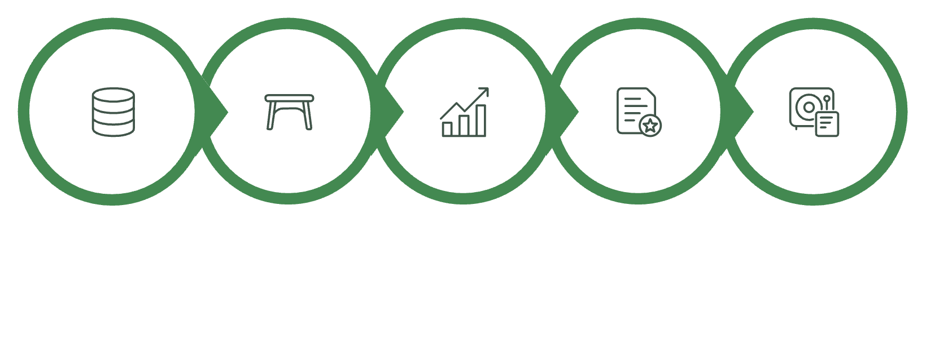
PYTHON ANALYSIS
Data Preparation Pipeline
Missing Data
New Features
37 review ratings imputed using category medians
Age groups and purchase frequency calculated
Explore Structure
Handle Missing Values
Engineer Features
Export to Database
Load Data
Systematic approach to cleaning and preparing 3,900 customer records for analysis
Standardization
Columns renamed to snake_case format

Slide 5
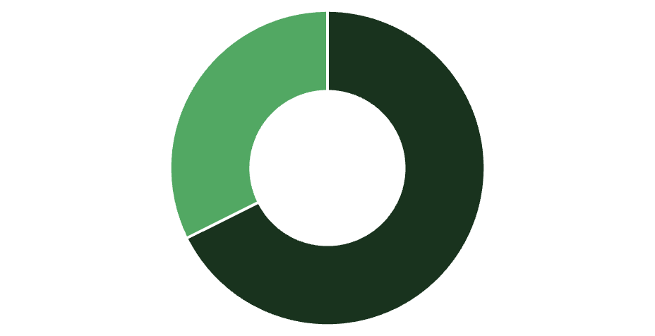


Revenue Insights by Gender
Male customers drive 68% of total revenue
Despite representing 68% of customers, male shoppers generate disproportionately higher revenue. This suggests opportunities for targeted campaigns to increase female customer engagement and spending.
Male
Female
68%
Male revenue share
32%
Female revenue share

Slide 6

High-Value Discount Shoppers
839 customers used discounts while spending above average
Above Average Spend
$60+ purchase amounts despite using discounts
These savvy shoppers represent a key segment: discount-motivated yet willing to spend. They're ideal candidates for loyalty programs and exclusive offers.
Strategic Opportunity
Target with premium product bundles and tiered rewards

Slide 7
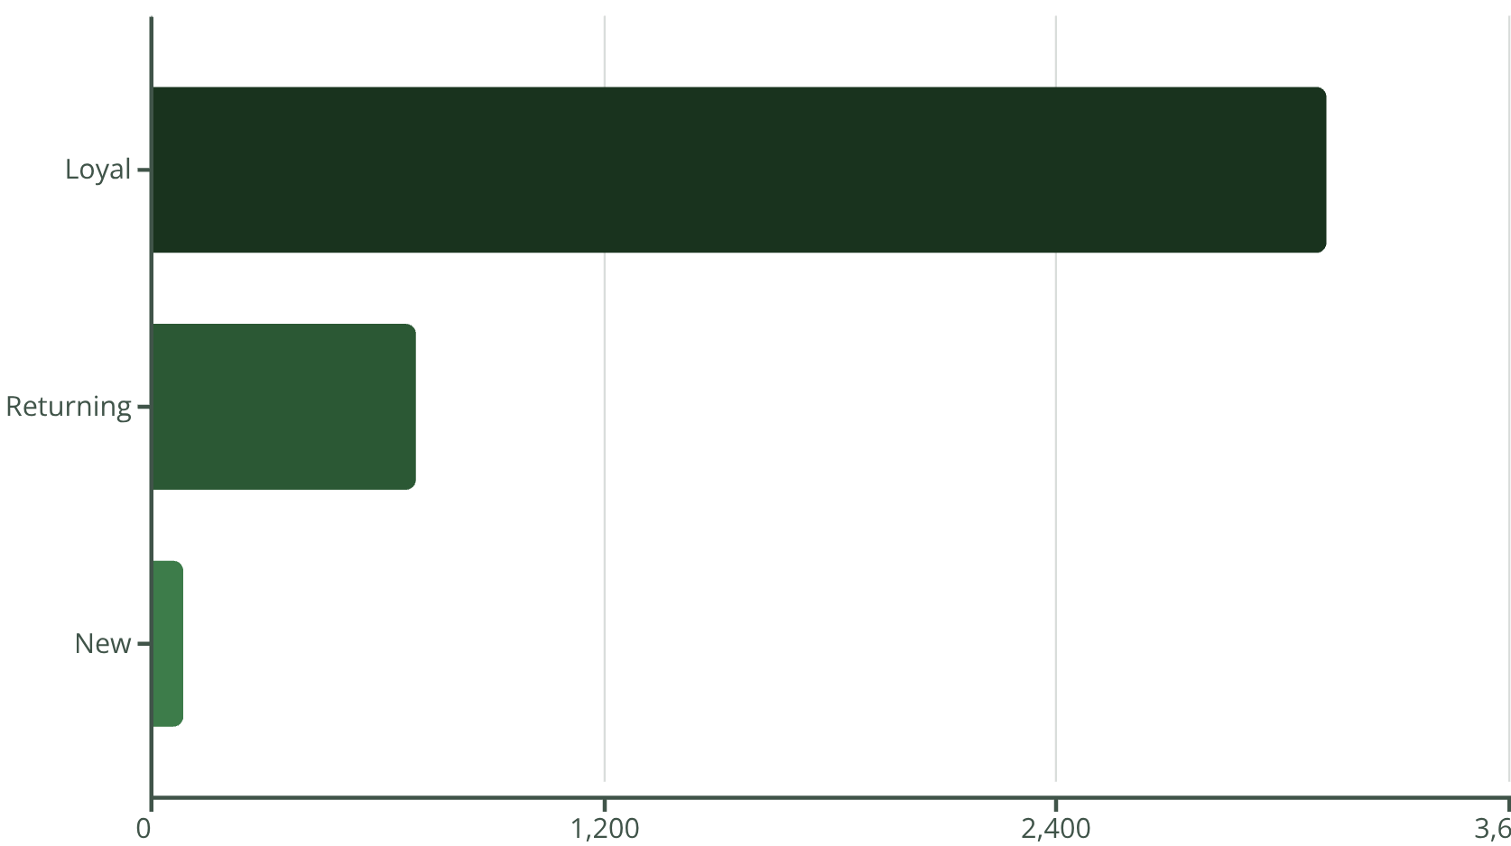



Customer Segmentation Analysis
80% of customers are loyal repeat buyers
Strong customer retention with 3,116 loyal customers. Focus on converting the 701 returning customers into the loyal segment through targeted engagement.
New (83)
First-time buyers
Returning (701)
2-5 purchases
Loyal (3,116)
5+ purchases

Slide 8

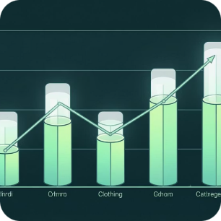
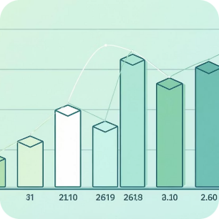
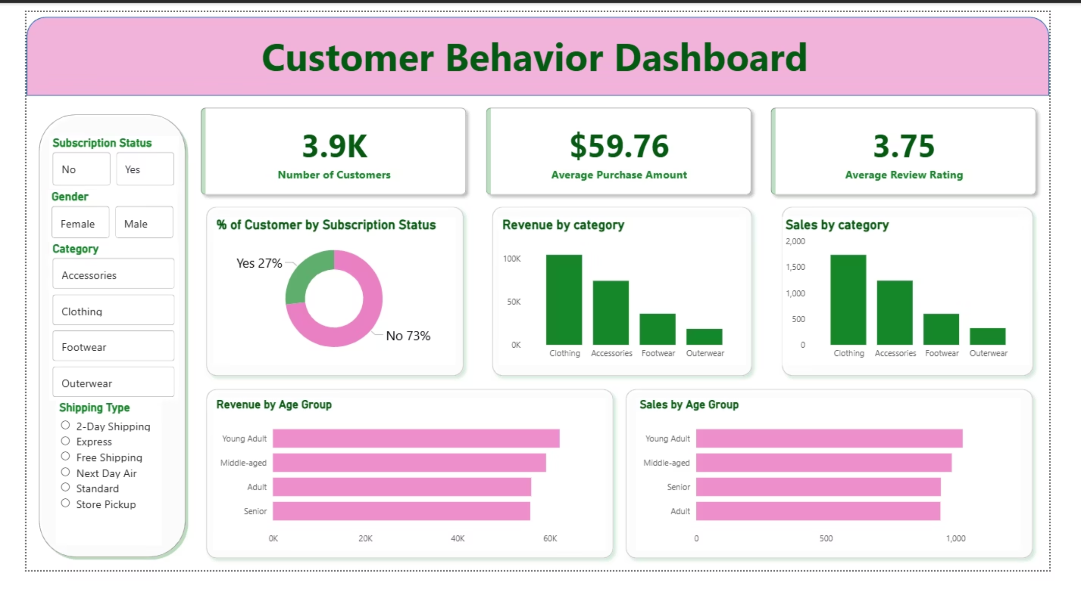
POWER BI
Interactive Dashboard Highlights
Subscription Split
Category Leaders
Age Distribution
27% subscribed, 73% non-subscribers
Clothing dominates with $100K revenue
Young adults generate highest revenue

Slide 9


Subscription vs. Non-Subscription Performance
Subscription opportunity: $170K untapped revenue
Non-subscribers contribute significantly more total revenue due to volume. Converting just 10% could add $17K in recurring revenue.
27%
Subscriber Avg
Non-Subscriber Avg
Growth Potential
$59.49 per purchase
958 repeat buyers not yet subscribed
$59.87 per purchase
Subscribers
1,053 customers
73%
Non-Subscribers
2,847 customers

Slide 10
Strategic Recommendations
Boost Subscriptions
1
Promote exclusive benefits to convert 958 repeat buyers into subscribers
Loyalty Programs
2
Reward returning customers to accelerate movement into loyal segment
Review Discount Policy
3
Balance 839 high-value discount users with margin protection strategies
Product Positioning
4
Highlight top-rated items like Gloves (3.86) and Sandals (3.84) in campaigns
Targeted Marketing
5
Focus on young adults and express shipping users for maximum ROI

